Slide 1
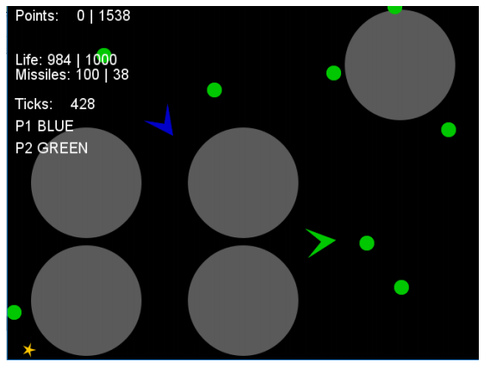
Game Design Tuning Sample Efficient Optimisation with NTBEA IGGI Games Design II
Simon Lucas and Diego Perez
and Jialin Liu

Slide 2
Games can be parameterised
Player performance can be measured
Games can be tuned
How best to do this?

Slide 3
Game Design: Also Noisy!
Can design a game
But each time an AI agent or human player plays:
The experience will be different
Due to the game, or the player actions
In a population of players each one may play differently
And therefore have a different experience
We can measure aspects of this experience
And view game design as noisy optimisation

Slide 4
Sample-Efficient Game Tuning
Tuning games with AI bots is relatively expensive
These short games may take 1 second or more to run
Even when running MUCH faster than real time

Slide 5
Expense of Agent-Based Game Evaluation
If a game is noisy, may need R repetitions to play it to gain a true picture of how it plays
Suppose each game lasts for T game ticks
In GVGAI, each tick is allowed 40ms i.e. 25 frames per second.
So the evaluation of a game for each agent (or each distinct pair of agents) takes:
(R * T) / 25
Typical vales: R = 5, T = 500, could need 100s per fitness evaluation
Can we do better?

Slide 6
Solutions
Use more efficient search algorithms that do clever resampling
Reduce the size of the search space
As a designer really think about which parameters you wish to vary
Use faster games – may achieve > 1m ticks per second
Be patient (I’m not good at this)

Slide 7
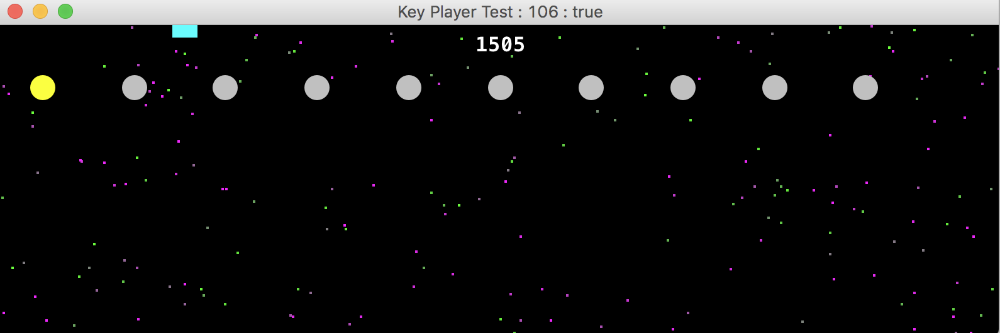
An Example Game Design Space CaveSwing Game (Lab Exercise)
For ease of use, place ALL game Params in to a single class – then objects of this class will specify instances of the game
Notes:
Mention interesting aspect of the Game – also run a Demo using the caveswing.test.KeyControllerTest

Slide 8
Cave Swing Params
public class CaveSwingParams { // duration public int maxTicks = 1000; // forces public Vector2d gravity = new Vector2d(0, 0.4); public double hooke = 0.02; public double lossFactor = 0.9999; // game map params public int width = 800; public int height = 250; public int nAnchors = 10; public double meanAnchorHeight = height * 0.2; // score related params public int successBonus = 1000; public int failurePenalty = 1000; public int pointPerX = 10; public int pointPerY = -10; public int costPerTick = 1;
…

Slide 9
Then code this in to an AnnotatedFitnessLandscape
public Param[] getParams() { return new Param[]{ new DoubleParam().setArray(xGravity).setName("x Gravity"), new DoubleParam().setArray(yGravity).setName("y Gravity"), new DoubleParam().setArray(hooke).setName("Hooke's constant"), new DoubleParam().setArray(lossFactor).setName("Loss factor"), new DoubleParam().setArray(anchorHeight).setName("Anchor height"), new IntegerParam().setArray(nAnchors).setName("Number of Anchors"), }; } double[] xGravity = {-0.02, 0.0, 0.02}; double[] yGravity = {-0.02, -0.01, 0, 0.01, 0.02}; double[] hooke = {0.0, 0.005, 0.01, 0.02, 0.03}; double[] lossFactor = {0.99, 0.999, 1.0, 1.01}; double[] anchorHeight = {0.2, 0.5, 0.8}; int[] nAnchors = {5, 10, 15};

Slide 10
Value of Fitness Landscape Modelling
Can lead to more efficient search
Fitter solutions are found more quickly
We learn more about the problem
Aim now is not just to find fittest possible solutions
But also estimate value of untested points in the search space

Slide 11
The N-Tuple Bandit EA
Combines an Evolutionary Algorithm
With a Bandit Landscape Model
So first: let’s look at multi-armed bandits
And how to combine them

Slide 12
The Multi-Armed Bandit Problem
At each step push one button
Noisy/random reward signal
In order to:
* Find the best arm
* Minimise regret
* Maximise expected return
Notes:
Show first part of Excel simulation

Slide 13
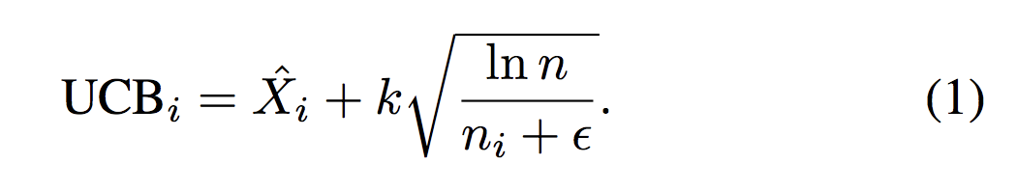
Which Arm to Pull? UCB Balances Exploration v. Exploitation
UCB1 (Auer et al, 2002)
Choose arm j so as to maximise:
Upper bound on variance (explore)
Mean so far (exploit)
Notes:
Show Flat MC, epsilon-greedy and UCB1 part of Excel demo

Slide 14
From Multi-Armed Bandit (MAB) to Combinatorial MAB (CMAB)
Consider tuning an algorithm or game
Number of parameters to adjust
Of various types (Boolean, double, int)
Unknown dependencies between them
Suppose also the cost function is noisy
Need to resample in order to reduce noise?

Slide 15
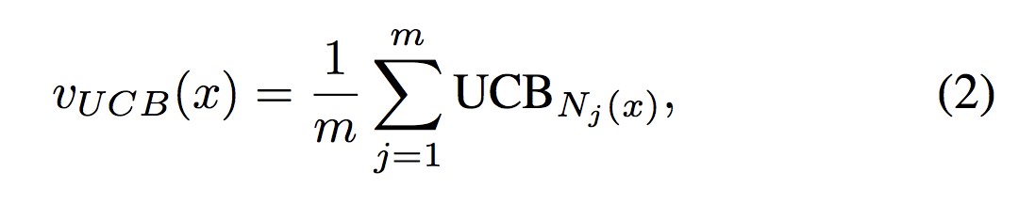
Now Take Average over ALL MABs Each time choose x with Highest UCB

Slide 16
Fitness Landscape Model Interface
public interface FitnessLandscapeModel {
void addPoint(int[] p, double value); // return a Double object - a null return indicates that // we know nothing yet; Double getSimple(int[] x);
// careful - this can be slow –
// it iterates over all points in the search space!
int[] getBestSolution(); int[] getBestOfSampled(); int[] getBestOfSampledPlusNeighbours(int nNeighbours); }

Slide 17
System Diagram
Note the fat connection between the EA and the landscape model
N-Tuple Bandit Fitness Landscape Model
Noisy Fitness Evaluator
Evolutionary Algorithm

Slide 18
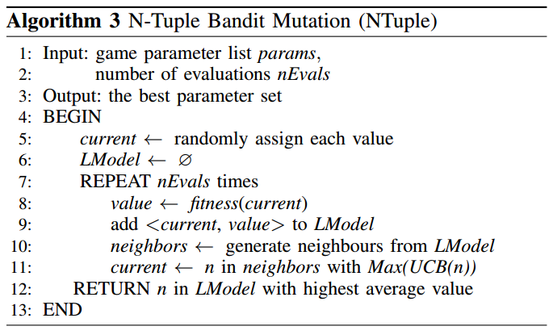
Bandit Landscape Algorithm
Each evaluation is noisy

Slide 19
The Bandit Landscape EA
int[] p = SearchSpaceUtil.randomPoint(searchSpace); while (evaluator.nEvals() < nEvals) { double fitness = evaluator.evaluate(p); banditLandscape.addPoint(p, fitness); EvaluateChoices evc =
new EvaluateChoices(banditLandscape, kExplore); while (evc.n() < nNeighbours) { int[] pp = mutator.randMut(p); evc.add(pp); } p = evc.picker.getBest(); } int[] solution = banditLandscape.getBest(); return solution;

Slide 20
Currently we Implement the Bandit Landscape Model as an N-Tuple System
N-Tuples are the best function approximator that no-one has ever heard of!
(bit like random forests)
Constant time access (independent of number of samples learned) One Shot Learning
Take projections of a high-dimensional space
Store values for each projection in a look-up table
Each n-tuple sample provides a table index
Novel contribution:
Each table entry stores a Statistical Summary Object
Notes:
Worth noting that the N-Tuple system used is not just a standard function approximator, since we also use it to estimate the number of times each point in the space has been visited (or the sub-samples of the point)

Slide 21
Statistical Summary Object class StatSummary
Each table entry is of type StatSummary
Provides efficient storage and access to:
Mean, Standard Deviation, Standard Error, Number of Samples, …
For the Bandit EA, we just need to know the mean and number of samples of each point in the search space, but also interesting to query other stats
Notes:
All these stats can be calculated efficiently independently of the number of samples stored.

Slide 22
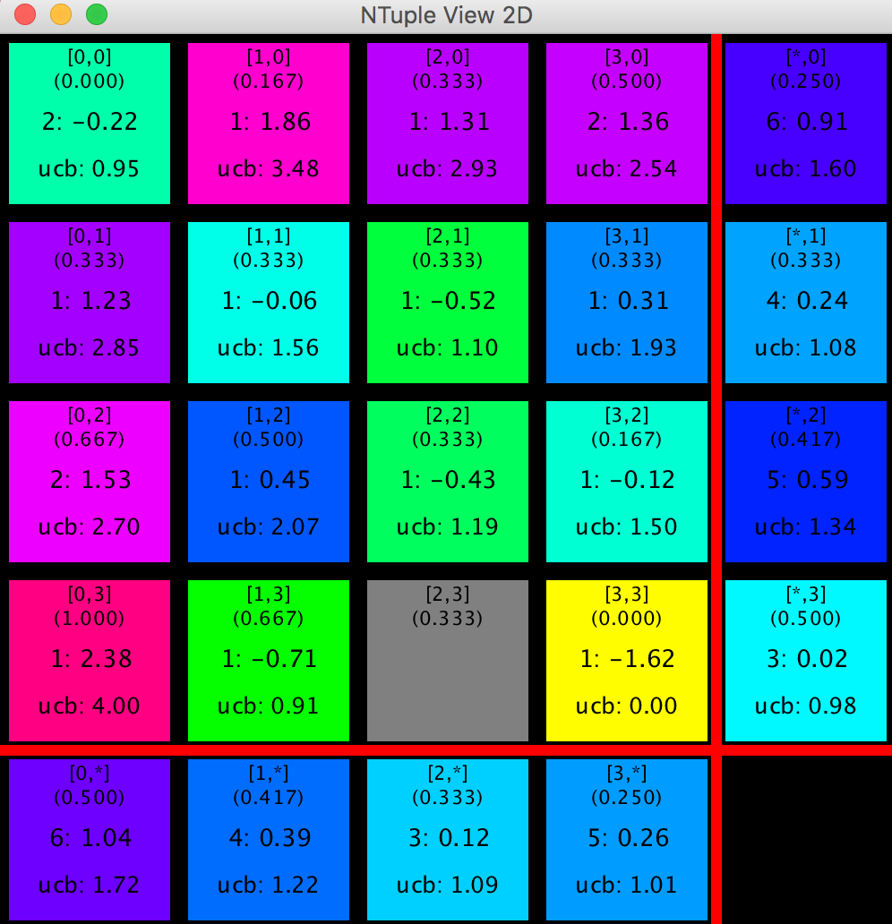
2-Dimensional Example
Notes:
This shows a two dimensional example. Each dimension has just four possible values so the search space has 4^2 = 16 points. The figure shows how the n-tuple model works. There are three n-tuples shown. The 4x4 grid is the 2-tuple that models each complete point. The bottom row and right-most column show the 1-tuples, which show the marginal statistics for each row column abd each row respectively.
Since we keep the statistics for all the entries in the tables, we can also estimate the uncertainty (standard error) of the mean of each point. This is interesting to know, so that when the search is complete and we get the final recommended point, we also know how reliable the game quality is, which is important to know.

Slide 23
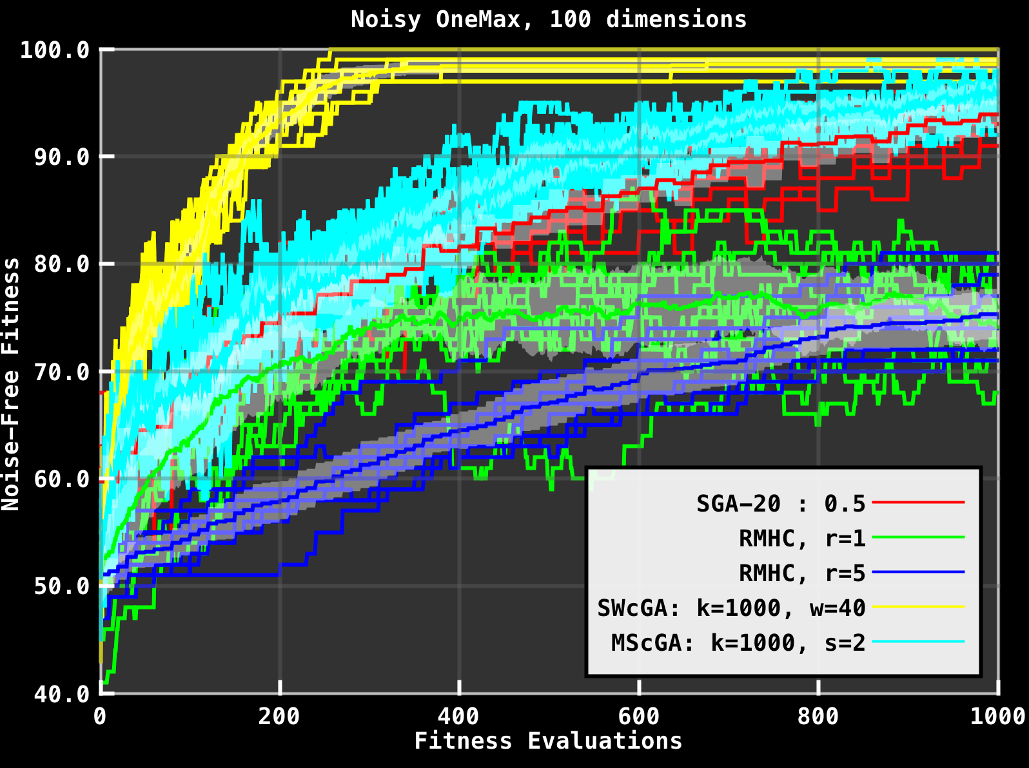
Comparing Performance 100-bit Noisy OneMax – Yellow is model-based

Slide 24
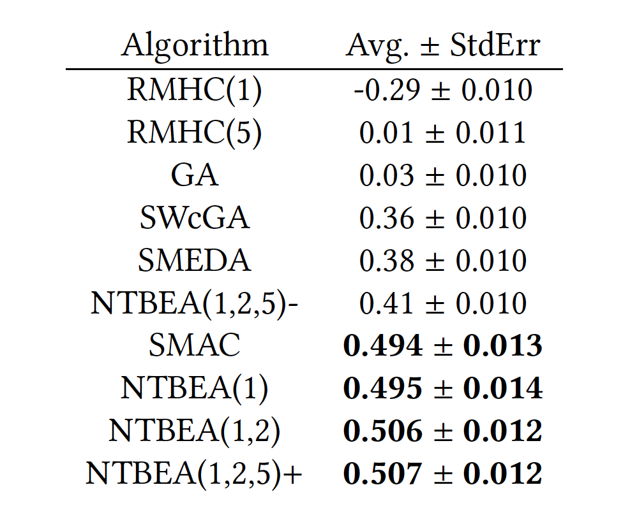
Optimising a Planet-Wars Rolling Horizon EA
Model based

Slide 25
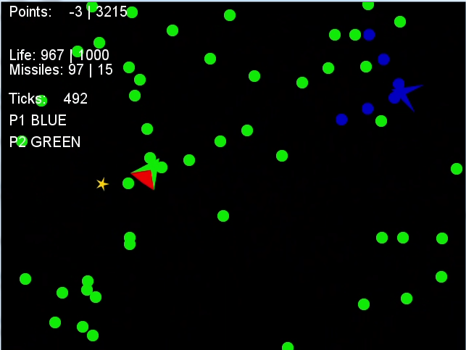
Example Game: Space Battle (Thanks to Mike and Raluca)

Slide 26
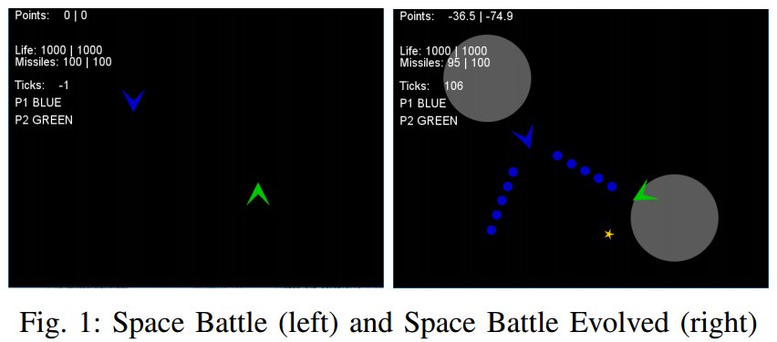
Evolving Space Battle Variants
You’ve already played with this a bit

Slide 27
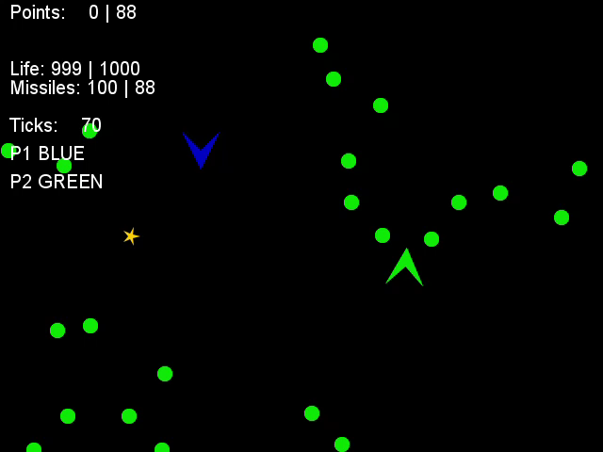
Unfit

Slide 28
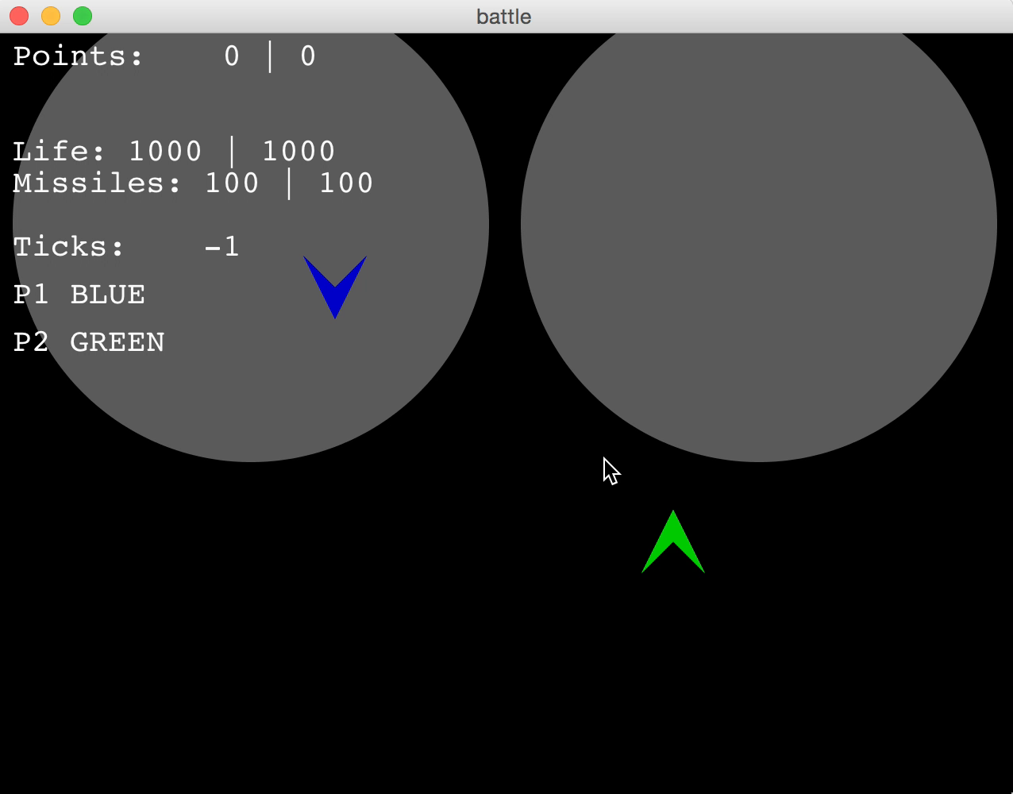
A bit fitter

Slide 29
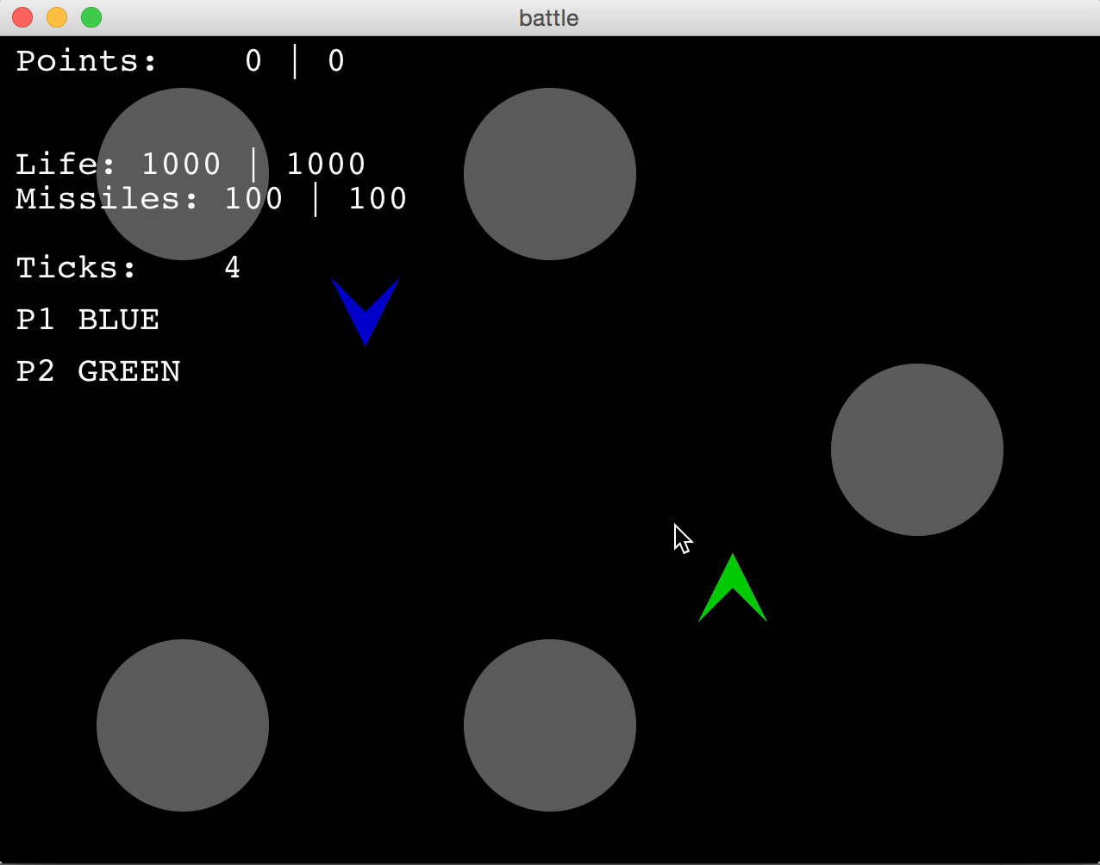
A bit fitter

Slide 30
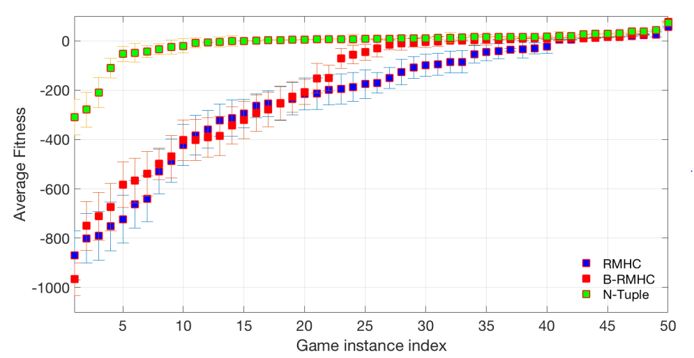
What this means for Space Battle This plot shows true fitness of individual return for each of 50 runs

Slide 31
Summary
Games have parameters
They can and should be tuned
Do this manually using your own insight
And also try to do it automatically
NTBEA is an Efficient Optimiser for this
You still have to come up with the Objective Function!

